Slide 1

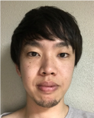
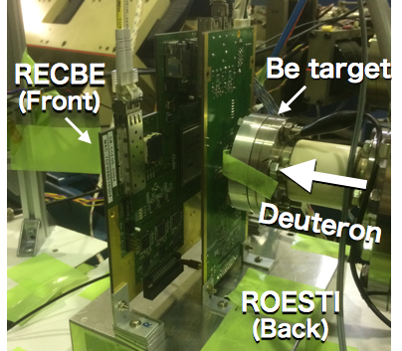
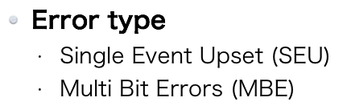
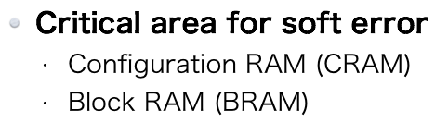
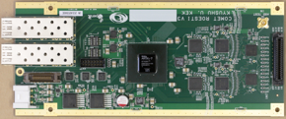
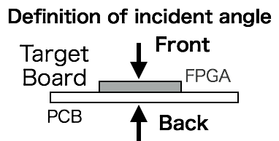
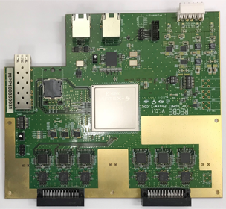
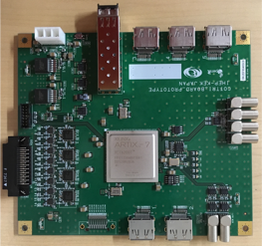
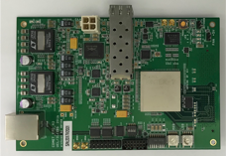
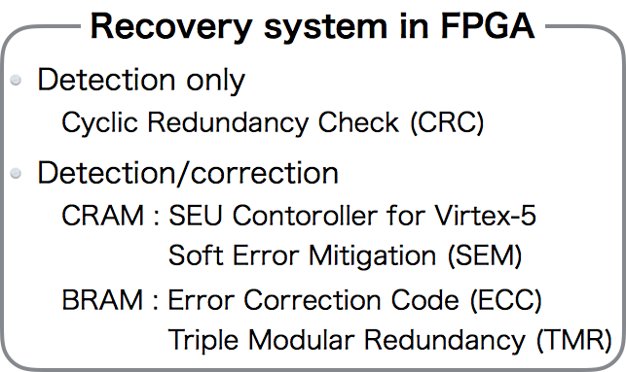
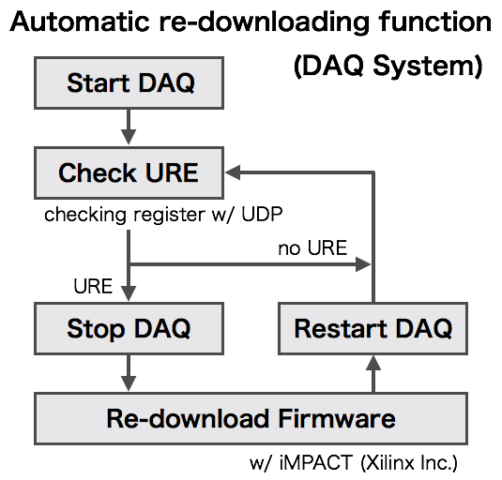
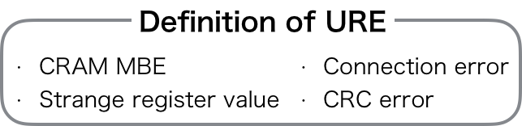
Radiation study of FPGAs with neutron
beam for COMET Phase-I
Yu Nakazawa¹, Yuki Fuji², Eitaro Hamada², MyeongJae Lee³, Yuta Miyazaki⁴, Akira Sato¹, Kazuki Ueno², Hisataka Yoshida¹, Jie Zhang⁵
¹Osaka University, Osaka, Japan; ²KEK, Tsukuba, Japan; ³IBS/KAIST, Daejeon, Korea; ⁴Kyushu University, Fukuoka, Japan; ⁵IHEP, Beijing China
Neutron fluence in COMET Phase-I
: 1.0 x 10¹² neutron/cm² (1MeVeq)
150 days measurement time
safety factor of 5~10
Neutron damage
Due to the neutron-nuclear interaction, a logic in FPGA can be affected.
Neutron irradiation test
TANDEM @Kobe Univ.
2 MeV neutron beam
Flux: 1.9 MHz/cm²/µA @ 10 cm from the source
Evaluation Item
Soft error rate
CRAM SEU & URE
BRAM SEU & MBE
Recovery system
TMR operation
Front-end electronics
FPGAs are used for digital signal processing
ROESTI
Auto-recovery system
Most of the soft errors can be repaired.
Re-downloading function is needed when an unrecoverable soft error (URE) occurs.
RECBE
COTTRI
FCT
Result
No permanent damage
Success
Auto-recovery system
TMR
Re-downloading function
Incident angular dependence
SEU rate
 | FPGA | FPGA Size [mm]
RECBE | Virtex-5 (XC5VLX155T-1FFG1738C) | 35 x 35
ROESTI | Artix-7 (XC7A200T-2FBG676C) | 27 x 27
COTTTRI | Artix-7 (XC7A200T-2FFG1156C) | 35 x 35
FCT | Kintex-7 (XC7K160T-2FFG676C) | 27 x 27
FPGA dependence of CRAM SEU rate was measured.
Dead time by soft errors can be suppressed by auto-recovery systems.
Frontier Detector for Frontier Physics: 14th Pisa Meeting on Advanced Detectors, La Biodola, Isola d’Elba, Italy, May 27th – June 2nd 2018

