Slide 1






Muon LFV/LFU measurements at J-PARC, PSI, FNAL
MEG II, COMET, PIONEER, etc.
with my personal bias…
Yusuke UCHIYAMA
KEK
HQL2025
@Beijing, China
September 15, 2025

Slide 2

The Muon
2nd-gen. charged lepton
Replica of electron but with 200 times larger mass
Only Higgs Yukawa coupling distinguishes e/μ.
  Gauge interactions don’t (Gauge symmetry)
  Lepton Flavor Universality
We still don’t know why it exists
  after 87 years from the discovery.
  “Who ordered that?” (Rabi)
γ, Z, W±
105.7 MeV/c²
0.511 MeV/c²

Slide 3

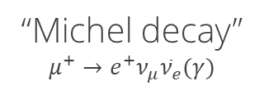

Muons decay weakly
$${\overline{ν}}_{e}$$
$$ν_{μ}$$
Muons decay only via weak interaction
Lifetime: 2.2 μs
  Long enough to manipulate and make a beam
Always lepton family/flavor number is conserved
The first unstable elementary particle
  The birth of flavor physics
“Michel decay”
$$μ^{+}→e^{+}ν_{μ}{\overline{ν}}_{e}(γ)$$
Sometimes, a photon can be emitted.
(Radiative muon decay, RMD)
This is the only kinematically allowed
decay mode.

Slide 4





Unique experimental systems
Free muon
Muonium
Muonic atom
Exotic “hydrogens/atoms”
$$e^{−}$$
$$μ^{±}$$
$$μ^{+}$$
$$μ^{−}$$
$$Nucleus$$
We can even stop μ⁺
Precise test for EW
（Omitted today）

Slide 5
Key points to design an experiment
1
One highly sensitive to new physics
  It’s not that searching for anything is a way to go―looking for something that doesn’t exist is meaningless.
One that leaves no room for doubt in the SM calculation
  theoretical systematic uncertainty. One free from hadronic uncertainty.
  If zero in SM, then there is no uncertainty.
One where experimental systematic errors and background estimation can be tightly under control
  calibration is essential. Estimate from data as much as possible.
  Can we understand all the possible backgrounds?
2
3
We need a conclusive experiment.

Slide 6
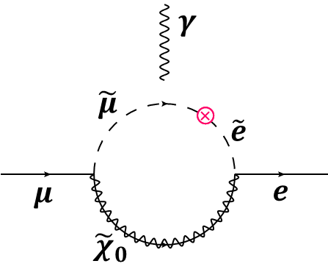
Search for CLFV
Providing definitive evidence for BSM when discovered
via “forbidden” process searches
  No theoretical uncertainty (unlike g–2)
  Little systematic uncertainty on BG estimation (unlike R_{K})
Connecting to ultra-high energy physics
GUT
10¹⁶ GeV
μ
TeV scale
e
Change lepton flavor

Slide 7
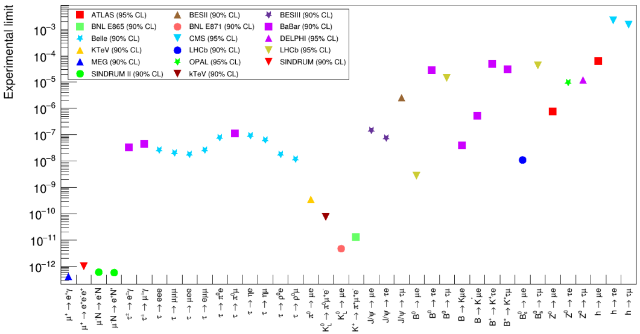
CLFV limits so far
M. Ardu and G. Pezzullo. Universe, 8(6), 2022.
Smallest branching-ratio limit among all particles

Slide 8
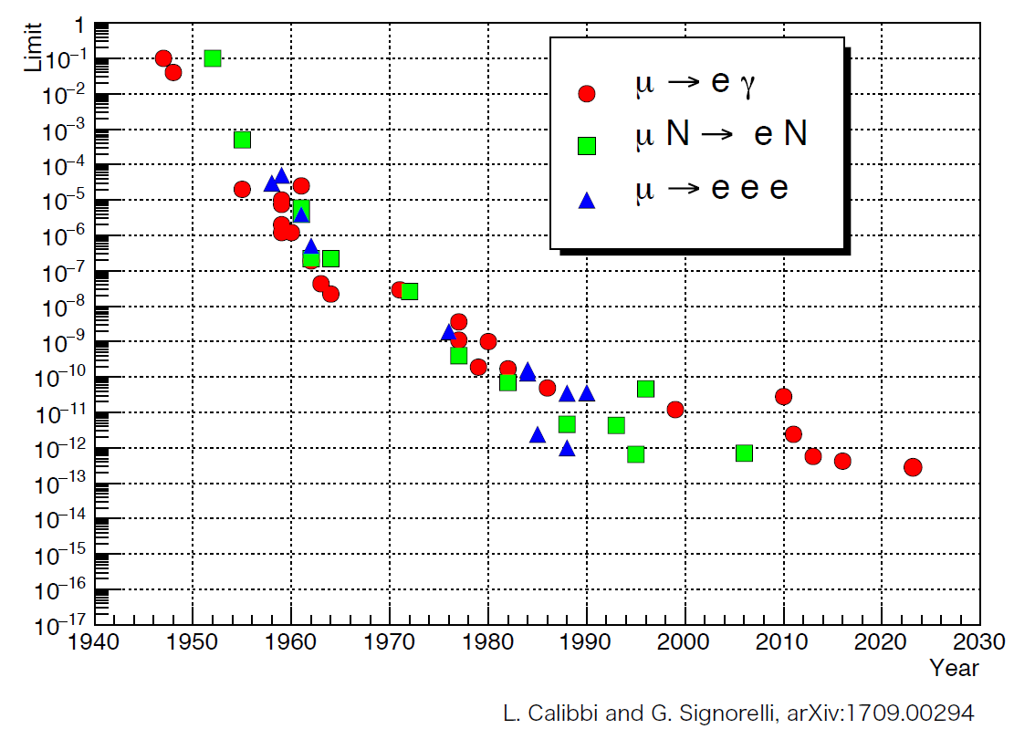

Only μ→eγ (MEG/MEG II)
results in the last 20 years
MEG
New
10⁻¹² – 10⁻¹³ Now
10⁻¹⁴ – 10⁻¹⁵ Near future
10⁻¹⁶ Future ($≥$10 y)
10⁻¹⁷ Far future (>20 y)
Sensitivity | N_{μ} measured | N_{μ} to target | Beam rate
O(10⁻¹⁴) | ~10¹⁵ | ~10¹⁶ | ~10⁸ s⁻¹
O(10⁻¹⁶) | ~10¹⁷ | ~10¹⁸ | ~10¹⁰ s⁻¹
Assumption: (Quasi-) BG free condition can be achieved.

Slide 9

Muon factories in the world
μ± are produced from π± decays
  π± are produced by hitting protons to a target, so μ± are tertiary beam.
  High-power proton drivers become muon factories.
Maximum intensity: 10⁸ s⁻¹ _{(now)} → 10^{10–11} s⁻¹ _{(in near future)}
FNAL
Mu2e
g–2
ISIS
PSI
MEG II
mu3e
muEDM
MuLan
Mu-Mass
HyperMu
muX
CREMA
MUSE
PIONEER
CSNS
J-PARC
COMET
DeeMe
g–2/EDM
MuSEUM
1S-2S
CiADS
HIAF
MACE
RCNP
TRIUMF
and more…
Leading meson/muon factories

Slide 10
Muon sources
Conventional method
New method
e.g., PSI, J-PARC MLF, CSNS MELODY
e.g., COMET, Mu2e, muon collider
To next target or
to neutron facility
To a beam dump
Multiple beamlines
in parallel
A dedicated beamline
Thin target
（40 mm-t graphite）
Thick target
（700 mm-t graphite
Or 70 mm-t tungsten）
Capture solenoid
Capture magnet
（150 msr）
MW beam
10⁸ → 10¹⁰ s⁻¹
kW beam
Mom. selection with
dipole and slits
10¹¹ s⁻¹
Mom. selection with
curved solenoid and collimator

Slide 11
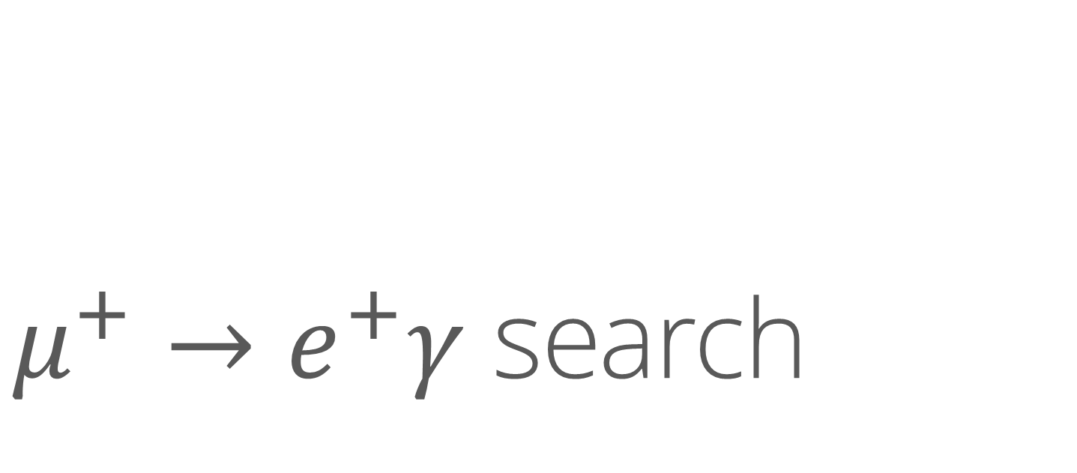
$μ^{+}→e^{+}γ$ search

Slide 12
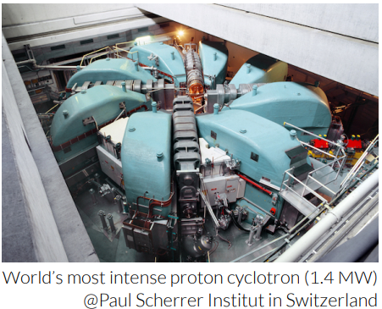
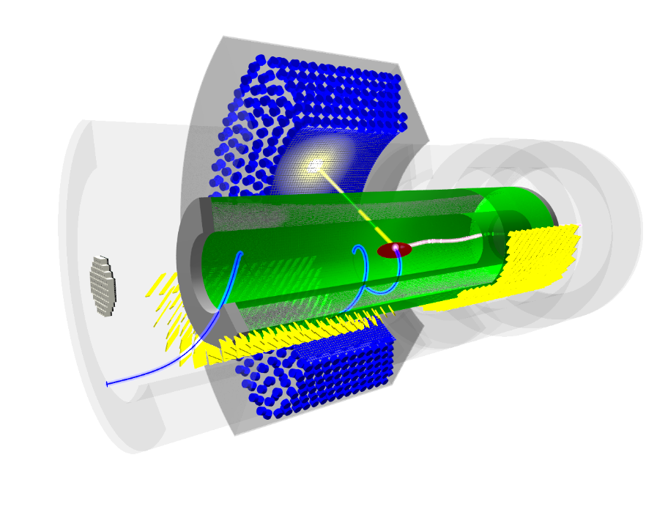
MEG II
Liquid xenon photon detector
(ε_{γ}~65%, σ_{E}/E~2%)
Thin-wall SC solenoid
(gradient B-filed: 1.3→0.5 T)
γ
Continuous μ⁺ beam
(5×10⁷ s⁻¹)
×10
improvement
from MEG
μ⁺
e⁺
Pixelated timing counter
(σ_{t} ≃ 35 ps)
Muon stopping target
(180 μm-thick scintillating film → Be film)
Cylindrical drift chamber
(~1.6×10⁻³X₀, σ_{p}~90 keV)
Radiative decay counter
(identify high-energy BG γ events)
Design: EPJ-C 78 (2018) 380
Performance: EPJ-C 84 (2024) 190

Slide 13
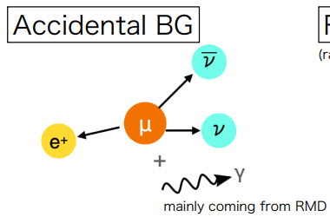
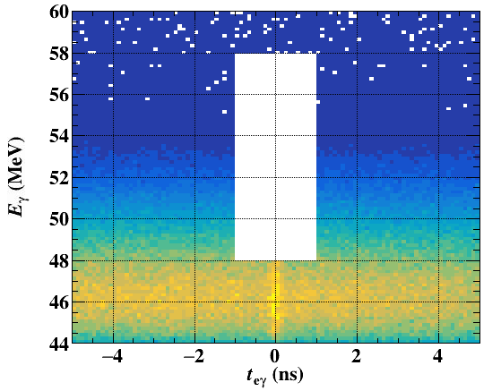
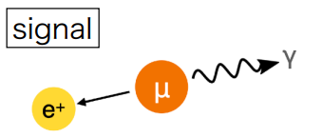
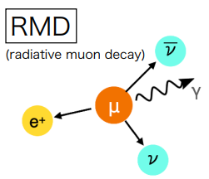
Analysis
Time sidebands → N_{Acc}
We need the rate (N_{BG}) and shape (PDF) of BGs.
Accidental BG
  Uncorrelated b/w e⁺ and γ
  Uniformly distribute for t_{eγ}
  Both rate and shape can be evaluated from “time sideband”.
  Completely data driven.
Physics BG (coincident)
  Kinematically-allowed modes are limited (only e±, ν, γ).
  μ→eννγ： Precise (electroweak) calculation available.
  Extrapolate from “E_{γ} sideband”.
  Negligibly low.
Blinded
E_{γ} sidebands → N_{RMD}
⇒ Little systematics enter the analysis

Slide 14
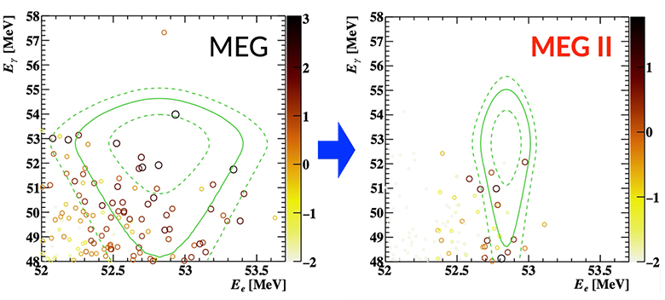
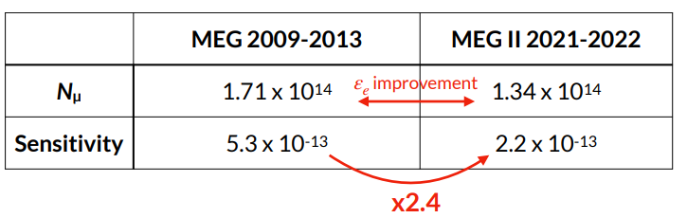
Latest result
arXiv.2504.15711
No excess was observed.
New limit
@ 90% C.L.

Slide 15
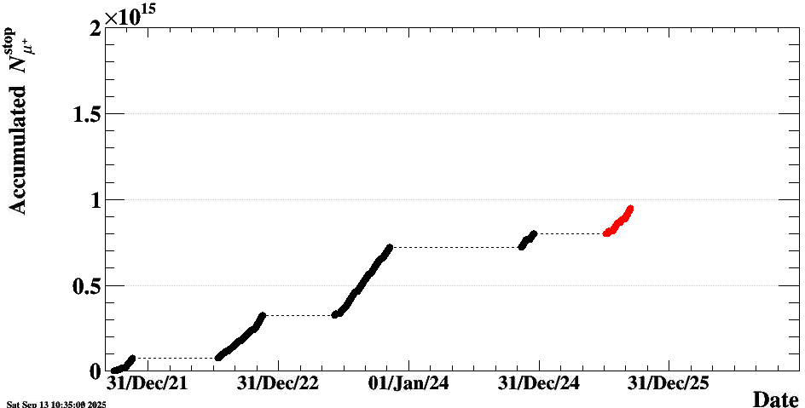

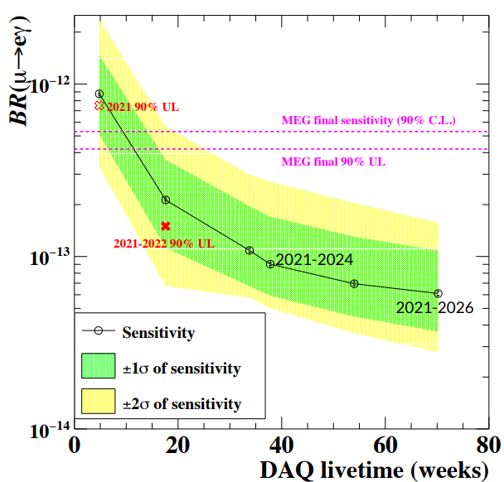
Prospects
How much can we go?
Being analyzed
Important to run
as long as possible
with highest efficiency
Latest result
Running
(live fraction × acceptance × detection eff. × analysis eff.)
We lost precious beam time due to
facility failure in 2024
Two constraints
Long shutdown in 2027–2028 planned
  to build a new high-intensity muon beamline (10¹⁰ s⁻¹)
Share πE5 beamline with Mu3e
  They also conduct phase I experiment before the shutdown…
Finish DAQ at
the end of 2026

Slide 16
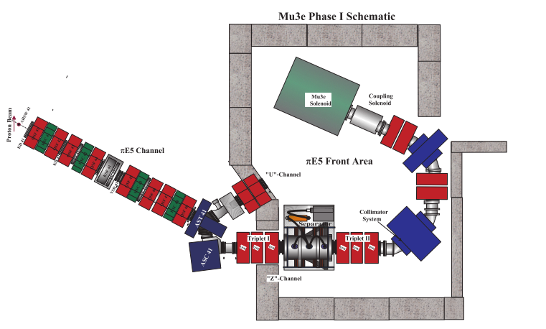
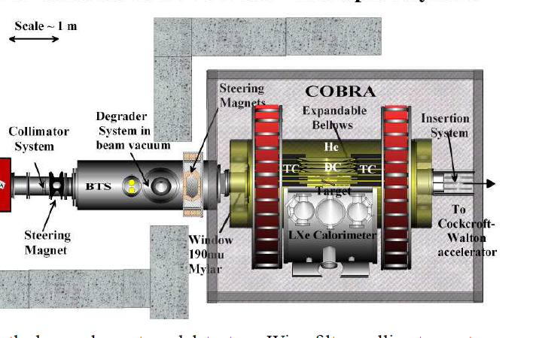
The piE5 beamline
Mu3e
MEG II
Primary proton beam
Surface μ⁺ beam
up to a few 10⁸ s⁻¹
E×B filter
to eliminate e⁺ contamination
Shared with Mu3e experiment.
  Two experiments cannot run in parallel.
  Mu3e started commissioning in 2025.
After MEG II (after long shutdown)
→ PIONEER
~2030–

Slide 17
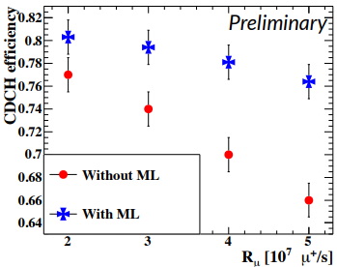
Prospects
How much can we go?
Being analyzed
Important to run
as long as possible
with highest efficiency
Improve analysis
Latest result
Running
@ 5×10⁷ s⁻¹
@ 4×10⁷ s⁻¹
(live fraction × acceptance × detection eff. × analysis eff.)
(Efficiencies & resolutions)
Tracking efficiency improved with ML
Finish DAQ at
the end of 2026

Slide 18
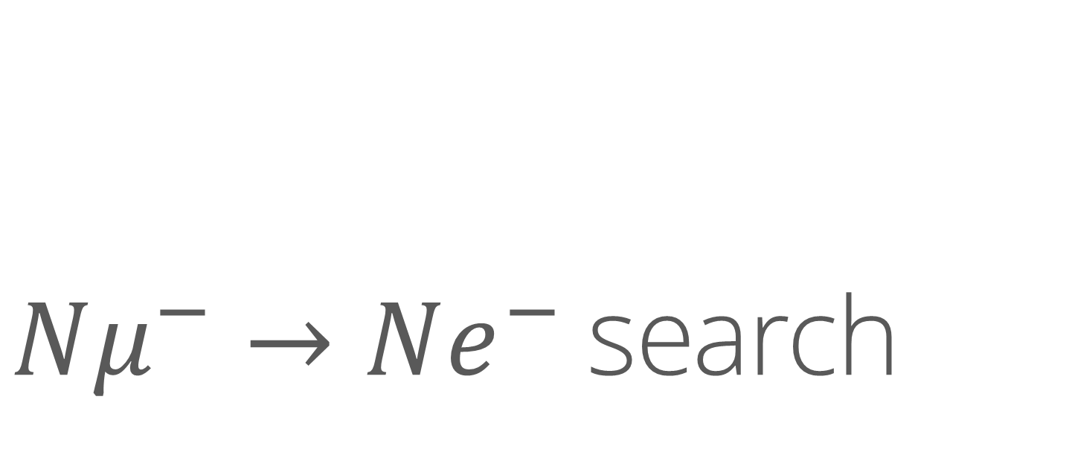
$Nμ^{−}→Ne^{−}$search

Slide 19
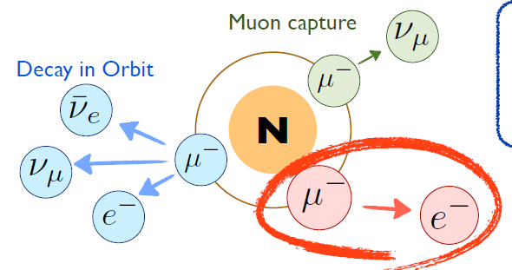
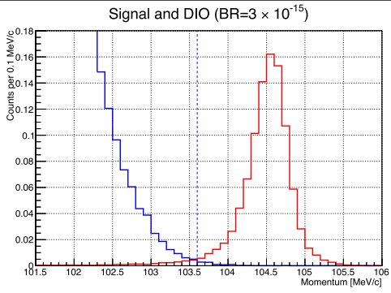
Principle
Stop μ⁻ in atoms → Muonic atoms
Search for μ⁻ → e⁻ process occurring in the nucleus field
DIO
BG
Signal
105 MeV for Al
BG origin | Sources | Measure
Muon | DIO, radiative capture | Resolution
Beam | π⁻ radiative capture ，e⁻，etc | Pure beam or delayed window
Cosmic-ray | Cosmic μ， knocked e⁻ | Veto
Reconstruction error | Hits by any radiation | Shielding
We cannot use any coincidence measurement to reduce BG.

Slide 20
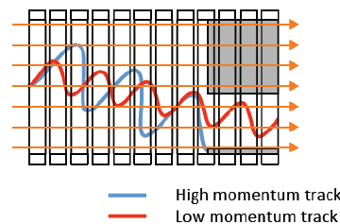
To suppress beam BG
Transport through curved solenoid
Making a pure beam
and/or
Using high-quality bunched beam
SINDRUM II @ PSI
COMET and Mu2e
Let pion decay
  Long beamline
Select by charge/momentum
  To remove unnecessary particles
Cut in time
  Bunched proton beam
  Use long lifetime of muon
  Start measurement after prompt BG passed through.
Primary protons
Prompt particles (e⁻, π⁻, μ⁻)
Particles from muonic atoms
DAQ window
0
1
(μs)
Ensure no residual protons
(Prob. < 10⁻¹⁰)

Slide 21
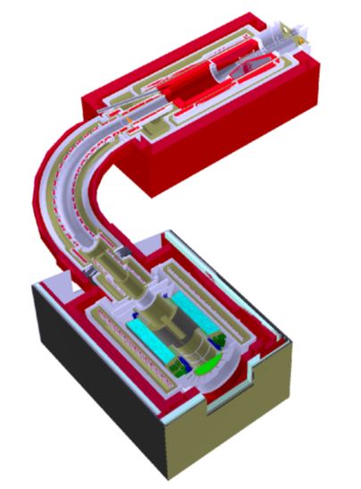
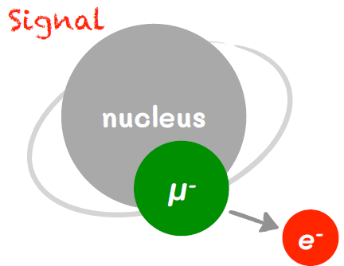
COMET phase I
21
Original COMET
（Phase II）
8 GeV proton
Upgrade
pion to muon
Proof of concept
Study beam & BG
Risk & cost reduction
Early physics outcome
Feedback
A vital step towards our final goal and beyond

Slide 22
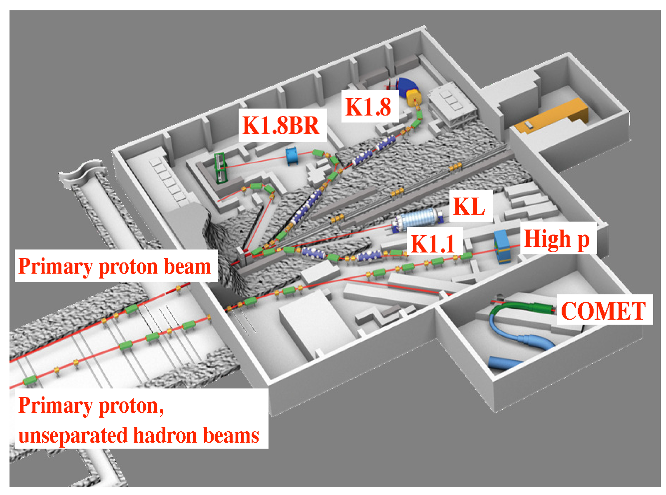
J-PARC
LINAC
0→0.4 GeV
Rapid Cycle Synchrotron
0.4→3 GeV
Main Ring
3→30 GeV
in our case
3→8 GeV
MLF
Hadron Experimental Facility
“8-GeV bunched slow extraction”
a special operation of the accelerator

Slide 23
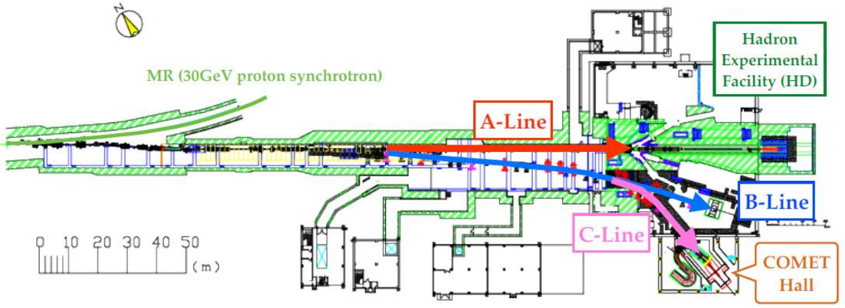
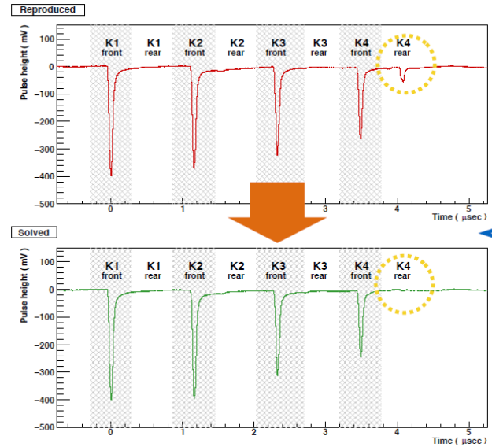
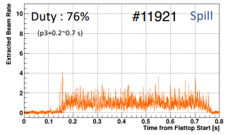
Achievements so far (2021–2023)
Demonstrated bunched SX with extinction < 10⁻¹⁰ (T78)
Completed C-line and commissed it
Demonstrated muon transportation
(Phase α)
Phase-α setup
8 GeV proton
from C-line
4×10¹¹ protons/bunch
~240 W
Extinction measurement
Muon transport solenoid
Spill time structure in Phase-α
π & μ
Target 1 mm-t
Shift kicker phase
Beam is ready

Slide 24
Status
All solenoids have been manufactured and delivered.
Detector construction and tests are steadily ongoing. Dry run in 2026.
Facility construction in parallel.
Connect capture solenoid
to transport solenoid
Cylindrical Drift Chamber
Dec. 2024

Slide 25
Plan
2 years for construction
Start experiment at low beam power (10%)
    300 W × 2 weeks DAQ exceeds SINDRUM II
    Demonstrate experiment
Move to full power Phase-I by increasing radiation shield
Phase-II
    Re-design based on Phase-I knowledge
    No funding approval yet: Discussion is underway on how to realize it including an international framework.
2025 | 2026 | 2027 | 2028 | 2029 – 2030s
Solenoids
Detector Preparation
Beam room
Low Intensity Runs
O(10⁻¹³)
O(10⁻¹⁵)
Data Taking

Slide 26
LFU test with pion

Slide 27
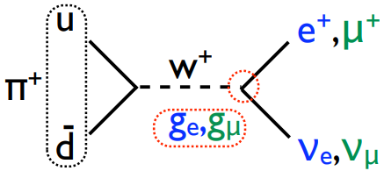
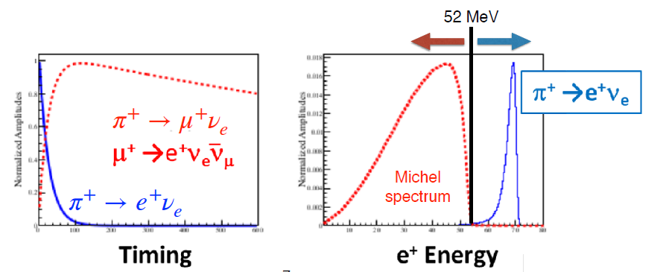




Pion decay
Lightest hadron → Only weak decay
$$ν_{L}$$
$e^{+}$or $μ^{+}$
Left handed
Helicity –
$$π^{+}$$
Spin 0
Right handed
Helicity –
（Mass）
$$𝒪({10}^{−4})$$

Slide 28
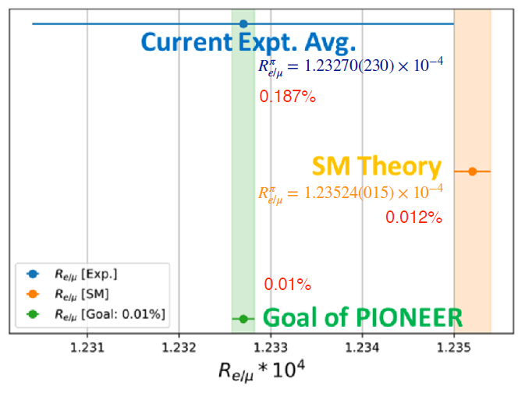
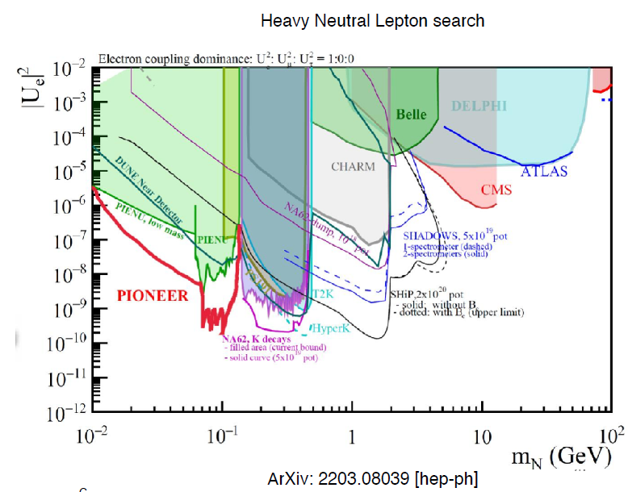
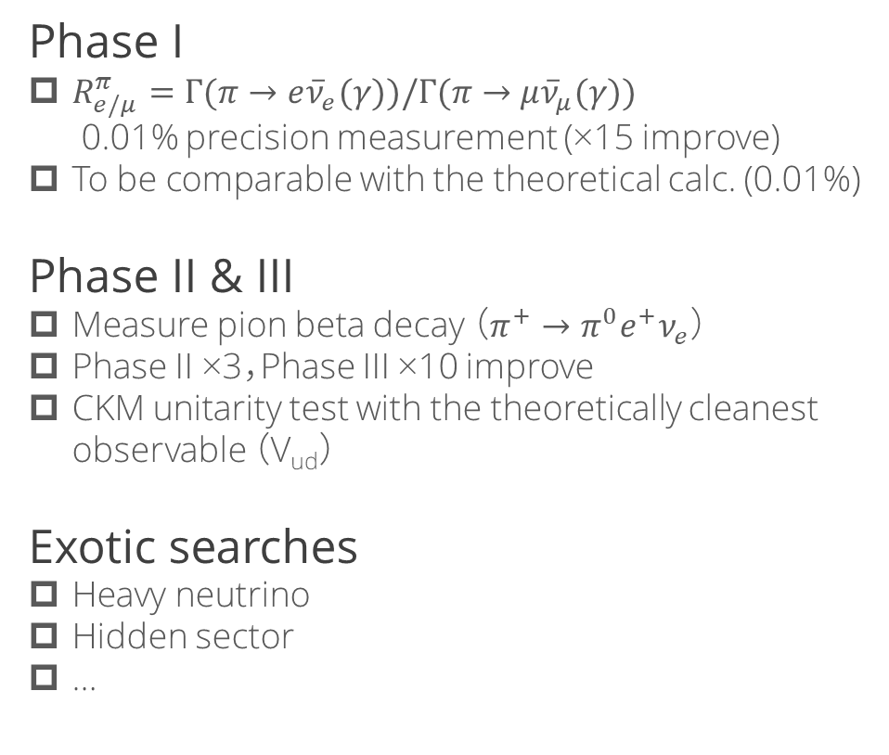
PIONEER goals
Phase I
  $R_{e/μ}^{π}=Γ(π→e{\overline{ν}}_{e}(γ))/Γ(π→μ{\overline{ν}}_{μ}(γ))$
  0.01% precision measurement (×15 improve)
  To be comparable with the theoretical calc. (0.01%)
Phase II & III
  Measure pion beta decay （$π^{+}→π^{0}e^{+}ν_{e}$）
  Phase II ×3，Phase III ×10 improve
  CKM unitarity test with the theoretically cleanest observable （V_{ud}）
Exotic searches
  Heavy neutrino
  Hidden sector
  …

Slide 29
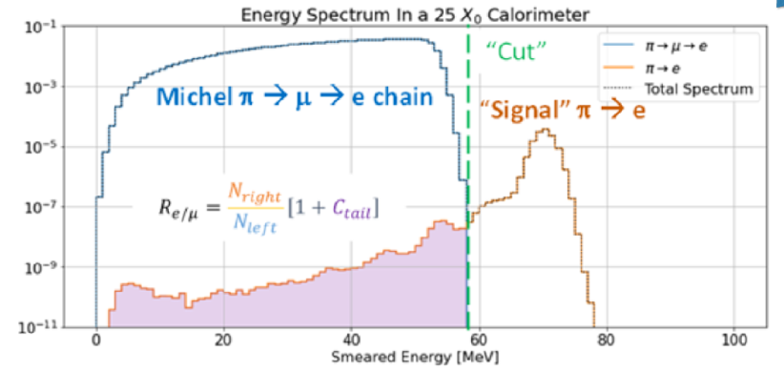
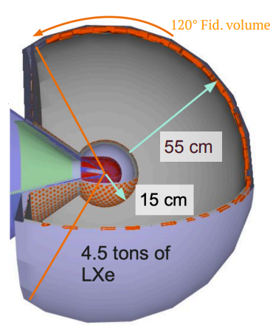
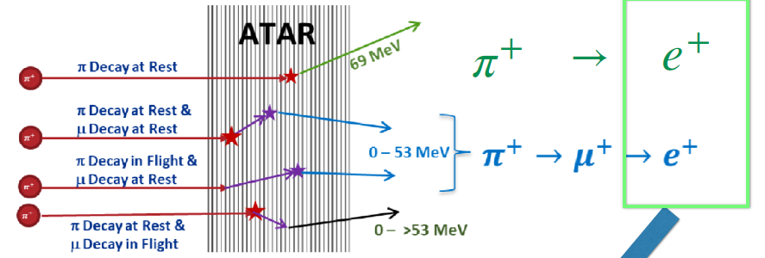
Major systematics and measures
High performance， hermetic， and thick
calorimeter to suppress energy escape.
Major systematics in past experiments stem from
the low-energy tail overlapped with Michel positron
π⁺
Distinguish e / μ events by
wide dynamic range，high granularity，
and 1 ns time resolution LGAD ATAR.

Slide 30
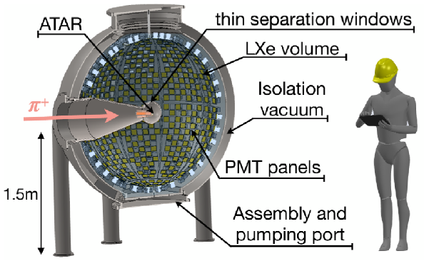
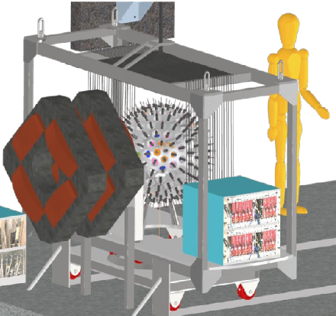
Calorimeter options
Liquid xenon
LYSO crystals
4 ton
3π coverage，~20 X₀
Simulation studies under way.
Decide after prototype tests.

Slide 31
Other experiments

Slide 32

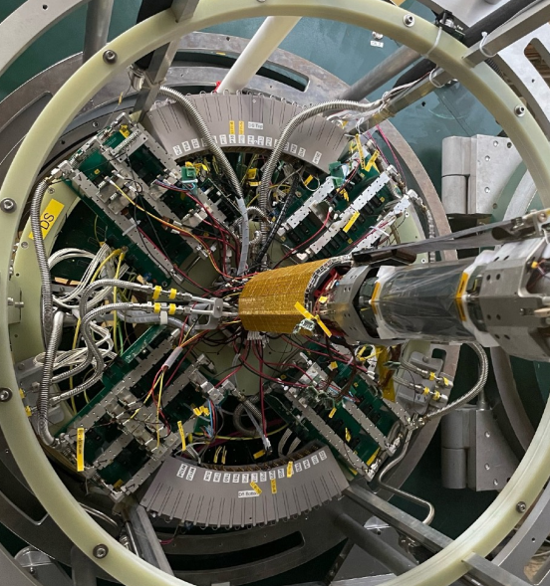
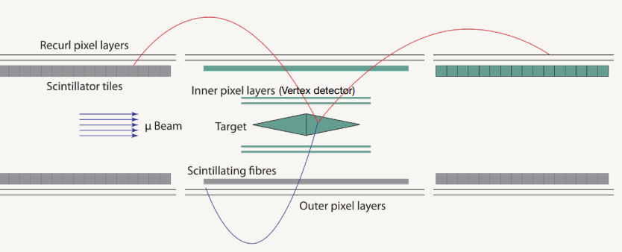
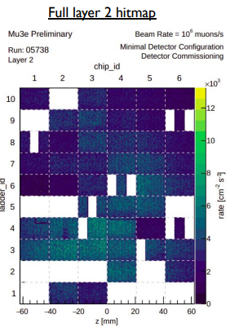
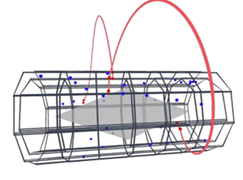
Mu3e
First commissioning run in June 2025
  Three-week beam time @ πE5
  with a full vertex detector and partial SciFi and scintillator tile detectors.
  DAQ and online GPU firmware.
  Stress test > 10⁷ μ⁺/s.
  Failure in 26 / 108 pixel sensors
First physics run before the long shutdown
  with full central station (Phase-0)
  After shutdown, resume @ HIMB (Phase-I) → O(10⁻¹⁵)
  Then, upgrade to Phase-II → O(10⁻¹⁶)

Slide 33
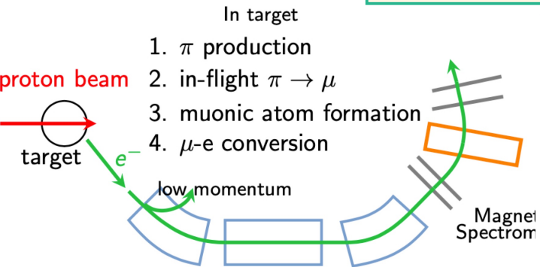
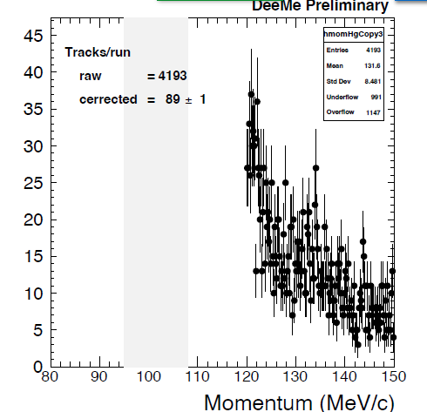
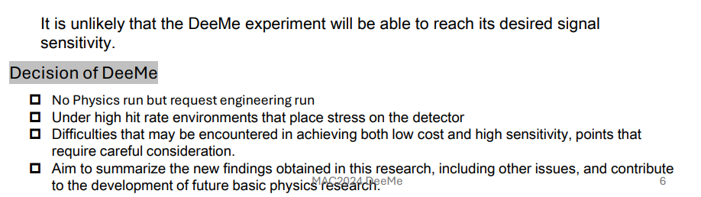
DeeMe
Another μ-e conv. exp. in J-PARC (MLF)
Gave up physics measurement
Huge backgrounds (N_{BG}~10⁷)
  Many delayed hits by prompt mu/pi
  Need to reduce them at least by factor 100.
Radiation control issue at H1
  Facility modification is necessary
Test measurement in 2022
J-PARC MLF MuPAC report (Feb. 2025)
2 μs delay

Slide 34
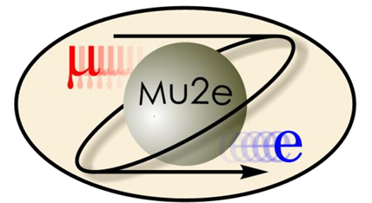
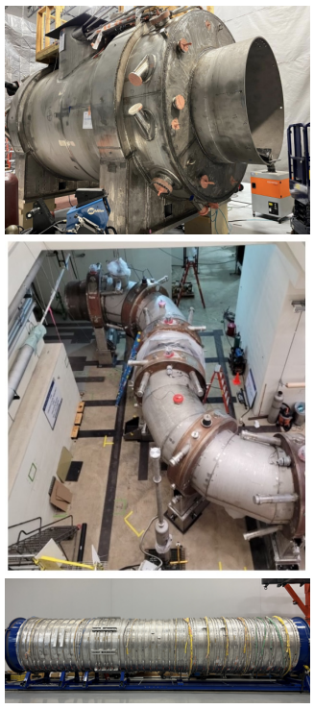
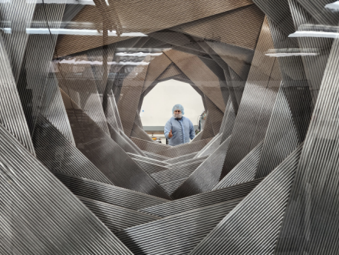
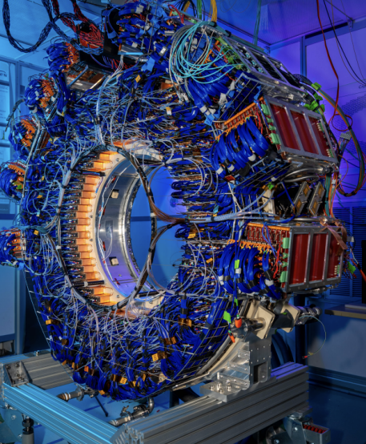
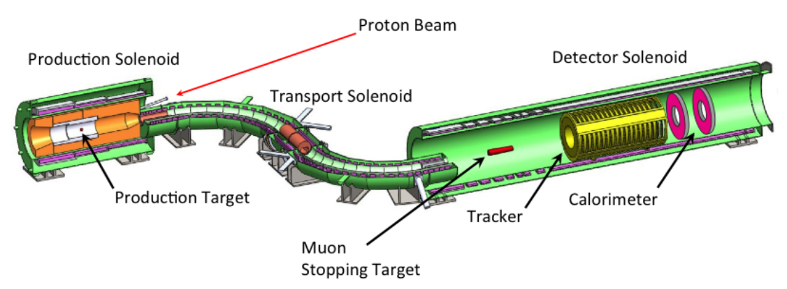

Mu2e
Status
  Production and Transport solenoids delivered
  Detectors constructed.
  Start cosmic runs (commissioning) from the end of 2025.
  Detector solenoid to be delivered in 2026
FNAL plans long shutdown in 2028–2029 (PIP-II）
Plan a few months Run1 before the shutdown
  Start with 3 kW beam.
bottleneck

Slide 35
Comparison
Official “quoted” sensitivity
 | DAQ year | Beam power | Live time | SES
COMET P1 LI | 2027 – 2028 | 300 W | 1.3x10⁶ s | (3×10⁻¹³?)
Mu2e R1 | 2027 | 3 kW | 6x10⁶ s | 4×10⁻¹⁶
COMET P1 | 2029 – 2032 | 3 kW | 1.3x10⁷ s | 3×10⁻¹⁵
Mu2e R2 | 2030 – 2033 | 8 kW | 6x10⁷ s? | 3×10⁻¹⁷
COMET P2 | 203X? – | 56 kW | 1x10⁷ s? | 3×10⁻¹⁷?
Mu2e II | 203X? – | 100 kW | 8x10⁷ s? | 3×10⁻¹⁸?
Major differences
 | COMET Phase-I | Mu2e
Slow extraction | Established (99.5% eff) | Not yet?
Extinction | Demonstrated (<10⁻¹⁰) | Not yet. AC dipole
Production target | Graphite (established) | Tungsten (high π yield, concern in sustainability)
Transport solenoid | 90° with dipole | S-shaped (smaller beam size), gradient.
Detector | Cylindrical | Forward, annular
Beam time | Exclusive b/w ν, Hadron, & COMET. ~50 days/year? | Simultaneous with ν. ~6 months/year.

Slide 36
Next decade
Include my perspective
2023 | 2025 | 2027 | 2029 | 2031 | 2033 | 2035
LHC Run3
LS3
HL LHC
MEG II
PSI HIPA shutdown
→ HIMB z
PIONEER I
PIONEER II
Mu3e I
Mu3e II
New μ→eγ?
COMET I
COMET II
Mu2e
PIP-II shutdown
Mu2e II ?
Fermilab g-2
CERN MUonE
J-PARC g-2/EDM
PSI μEDM I
PSI μEDM II
LS1
Belle II
LS2
Belle II
T2K II
Hyper Kamiokande
Rich program in late 2020s to 2030s

Slide 37

Conclusions
Physics of “LQL” are also interesting.
Today to next decade, hot period for CLFV search with muon
  Now
  MEG II lates result: new upper limit$\sim 1.5×{10}^{−13}$
  Down to ~6×10⁻¹⁴ in a few years
  In a few years
  Mu3e, COMET, Mu2e will finally start
New high-intensity muon source will be a key item for particle physics experiments in 2040s
  However, too ambitious goals would never be realized. Step-by-step progress is only the way.
  Success of the COMET Phase-I is the first step.
Important to keep running experiments
  to make the field active and attractive.
  Start with minimum goals, then, improve / upgrade.

Slide 38


History
MECO
@BNL
Revival of MECO with the same concept
Cancelled in 2005
UCI (W. Molzon)
joined to MEG
Introduce different concept (techniques)
Project next to MECO
“PRISM/Phase-I”
“COMET”
“COMET Phase-I”
“COMET Phase-II”

Slide 39


Slide 40

8 GeV bunched SX ＠ J-PARC MR
Slow extraction (0.5 s, duty cycle~25%)
# of protons， Energy
8 GeV
3 GeV
1 spill
0
1
2
3
4
5
Time (s)
Special operation of accerelators
to get unique beam
Cannot simultaneously run with
other experiments at MR
1.2 μs
・・・
Measurement
window
Key parameters
Extraction efficiency (>99.5%)
Spill duty factor (>70%)
Extinction factor (<10⁻¹⁰)

Slide 41


Slide 42


Slide 43


Tungsten target
Radiative-cooling tungsten target: a big concern
Tungsten has the highest melting point among metals, but
Show embrittlement @<1200 K by recrystallization or radiation damage.
1500 K @ 8 kW → crumble to pieces and break
Try to solve it (lowering temperature) by improving emissivity.
Go with W or change material (graphite, Inconel?)??

Slide 44
Future

Slide 45

COMET (J-PARC)
Mu2e (FNAL)
Mu3e (PSI)
MEG II (PSI)
New μ→eγ (PSI)
Mu2e-II (FNAL)
AMF, PRISM
2040
2050

Slide 46


Facility upgrades (1)
PSI HIMB: a new high-intensity muon beam
for μSR
for particle physics
Normal-conducting capture solenoids
10¹⁰ µ⁺/s @2.4mA of 590 MeV proton beam
beam spot: σ_{x} ∼ σ_{y} ∼ 40 mm
Installation & commissioning in 2027–2028,
in operation from 2029.

Slide 47


New μ→eγ experiment
Target O(10⁻¹⁵) sensitivity
  HIMB@PSI （up to 10¹⁰ s⁻¹）
  Measurement after the discovery
    Precision measurement of BR
    Angular distribution
Key points
Gain stat. with large acceptance to use as low intensity beam as possible.
High-resolution, high-efficiency photon measurement with an active pair spectrometer
Separate photon origin with segmented targets
Si active target and Si pixel sensor for e+ high resolution measurement at high rate
Conceptual designing ongoing

Slide 48


Facility upgrades (2)
Proton Improvement Plan II (PIP-II) @ FNAL 2029–
  1.2 MW proton driver (upgradable to multi-MW)
  Primary goal is a neutrino experiment (DUNE)
  Use 800 MeV p from PIP-II linac for Mu2e-II (~100 kW)
High flexibility & expandability
  → Advanced Muon Facility (AMF) option → ultimate μ-e conv. experiment with PRISM (~1 MW)
  → CW beam option → μ→eγ, eee experiments. Intensity orders of magnitude higher than HIMB.
  → Muon collider frontend option
~2035–
~2045??–
AMF concept
Similar to muon-collider front end

Slide 49





A blueprint
Towards an ultimate CLFV experiment O(10⁻¹⁹)
FFAG-based phase rotating storage ring
High intensity (10¹² s⁻¹), monochromatic, high purity muon beam
Measurements with heavier targets
68 MeV/c
Technical synergy with νSTORM
1–6 GeV/c
FFAG
arXiv:2203.07545

