Slide 1

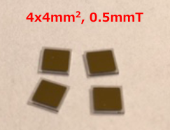
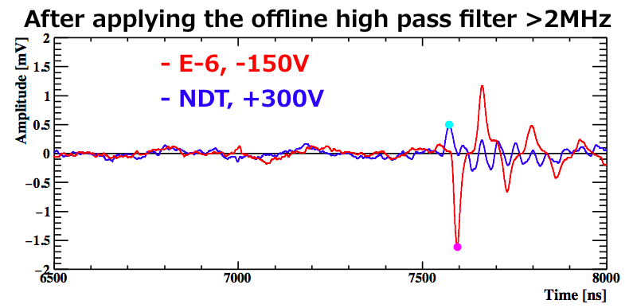
Development of the proton beam monitor based on the thin diamond crystal for the COMET Experiment
Diamond based proton beam monitor (PBM) is quite important for COMET to search for the μ-e conversion with a single event sensitivity down to 10⁻¹⁷.
Since a diamond detector is a brand new technology as for the particle detector, especially for use of the single particle identification, the prototype detector was developed to investigate its precise performance and the technical difficulties. The prototype detector consists of two single crystal diamonds with a uniform square shaped contacts, and a 200μm ultra thin ceramic PCB as shown in Figure1 and Figure2.
According to the measurement using an Am241 (5.5MeV α source), the expected pulse height due to a single proton is calculated to be less than 0.4mV. Therefore the strong noise reduction is essential in order to discriminate the single proton with the prototype detector both online and offline. The measurement of the small number of protons was conducted in the winter of 2018 using this prototype at J-PARC. As a result, we successfully observed the signal due to the small number of protons as shown in Figure3 and the baseline analysis method including the offline noise reduction was developed. However, the measured noise level was around 0.15mV, and it was found that further noise reduction is necessary.
Y.Fujii,
KEK, Tsukuba, Japan
yfujiI@post.kek.jp
Figure1. Diamond crystals with square shaped metal contacts.
Figure2. A prototype diamond detector based on the special thin ceramic PCB.
Figure3. An example of waveforms measured by two different diamonds with a small number of protons. One is a CVD (Chemical Vapor Deposition, from Element-6) diamond and other is a HPHT (High Pressure High Temperature, from New Diamond Tech.) diamond.

