Slide 1

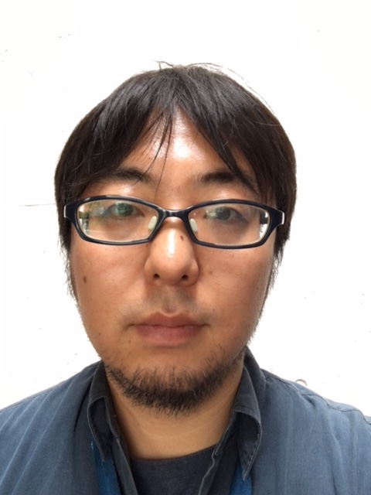
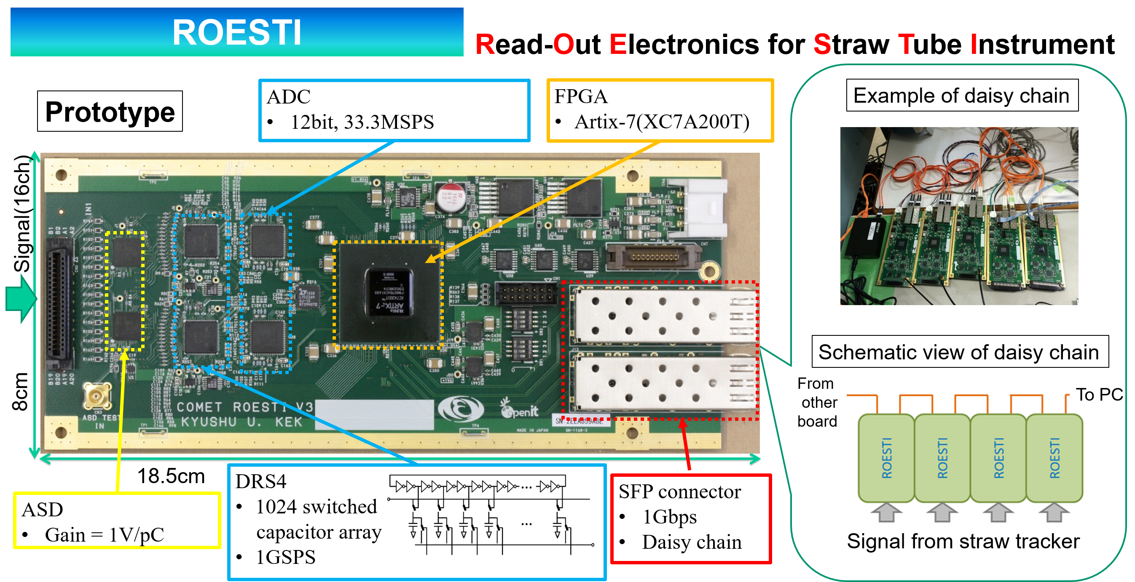
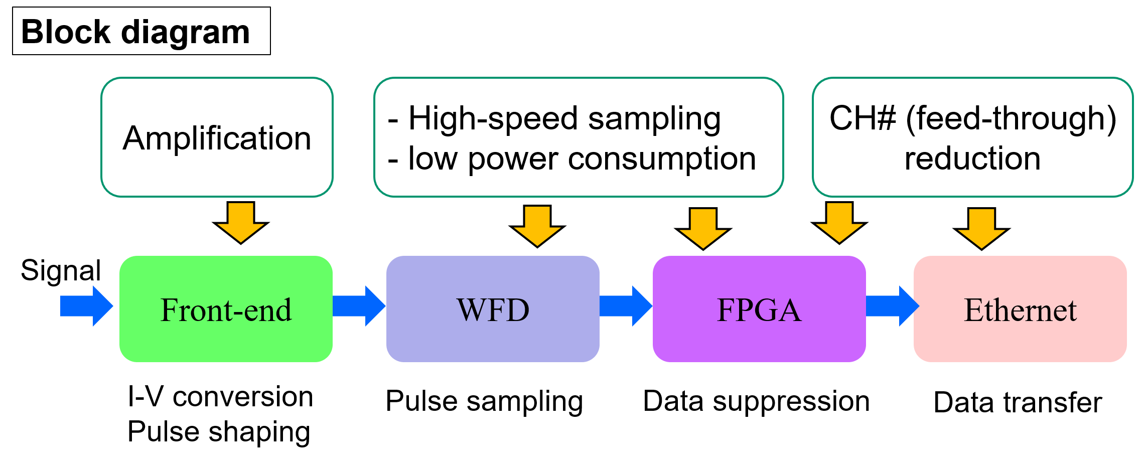
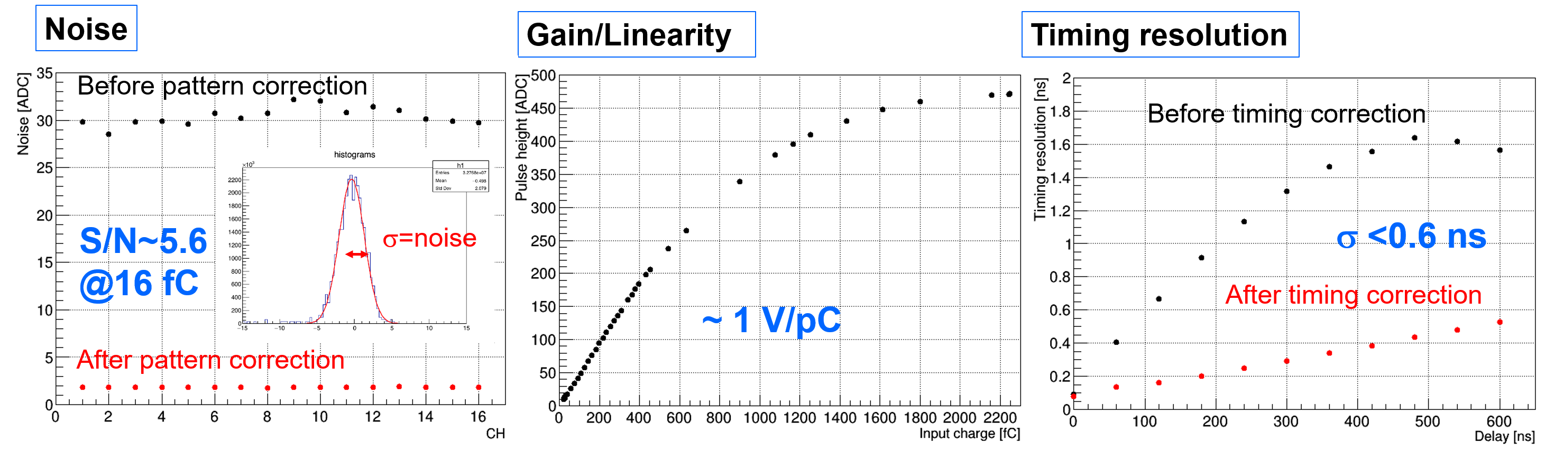
Design and performance evaluation
of front-end electronics
for COMET straw tracker
Kazuki Ueno¹, Eitaro Hamada¹, Shohei Hashimoto², Masahiro Ikeno¹, Satoshi Mihara¹, Hajime Nishiguchi¹, Tomohisa Uchida¹, Hiroshi Yamaguchi¹,
¹KEK, ²Kyushu University
We have designed and developed front-end electronics for COMET straw tracker which is called ROESTI.
Performance evaluation for the ROESTI was performed and we confirmed that the performance satisfied our requirements.
Param. | Req. | Meas.
Gain | 1 V/pC | ~1V/pC
S/N @ 16fC | 5 | 5.6
Timing res. | 1 ns | <0.6ns

